Slide 1


R FINAL PROJECT
Didem Beyza Kesik
Gizem Yüksel

Slide 2
INTRODUCTION
1. Introduce Your Data:
The data employed in the study were obtained from the follow-up visits of the patients, and entail clinical details of a sample comprising of 299 heart failure patients. This data was collected to find out various reason that contribute to high mortality rate among patients with heart failure so as to identify prognosis factors for survival and factors that define the risk that is associate with the disease.
2. State Your Goal:
In this case, therefore, the study is a step towards striving to determine some of the factors that can be used to predict mortality ratios of heart failure patients. More specifically, we aim at finding out more about which of these indicators ought to be of worry in raising the odds of death. It may also help in enhancing the awareness of health care treatment and or enrich the method applied in handling patients in different health facilities.

Slide 3
BRIEF OVERVIEW OF KEY VARIABLES
Age: Shows the age of the patient, as patient’s age is an important factor in HF development.
Anaemia: There is presence of anemia, this is due to low Red Blood Cell count or low Hemoglobin levels.
Creatinine Phosphokinase (CPK_Level): Among the known measures of enzyme levels, this tests the patient for the levels of enzymes characteristic of stress in heart muscles.
Diabetes: This is a flag for indicating whether the patient has diabetes or not.
Ejection Fraction: The amount of blood pumped per beat by the heart; smaller figures may indicate that the heart is not working well.
High Blood Pressure: Is used to determine whether the patient has high blood pressure, a great concern to heart failure.
Platelets: Blood platelet count, also or also known as thrombocyte, which plays a significant role in the clotting of the blood.
Serum Creatinine: This measures the performance of the kidneys and the actual rate of filtration of blood in the body.
Serum Sodium: Potassium and sodium balance; proper sodium levels in the blood indicate a risk of developing severe complications in heart failure.
Sex: Patient's gender.
Smoking: This includes the current smoking status of the patient.
Time: Number of patients, important for patient population assessment and comparison, number of deaths, essential for patient survival analysis, duration of follow-up in days, useful in patient survival analysis.
Death Event: Thus, the outcome variable in the study is death of the patient during the follow-up period.

Slide 4
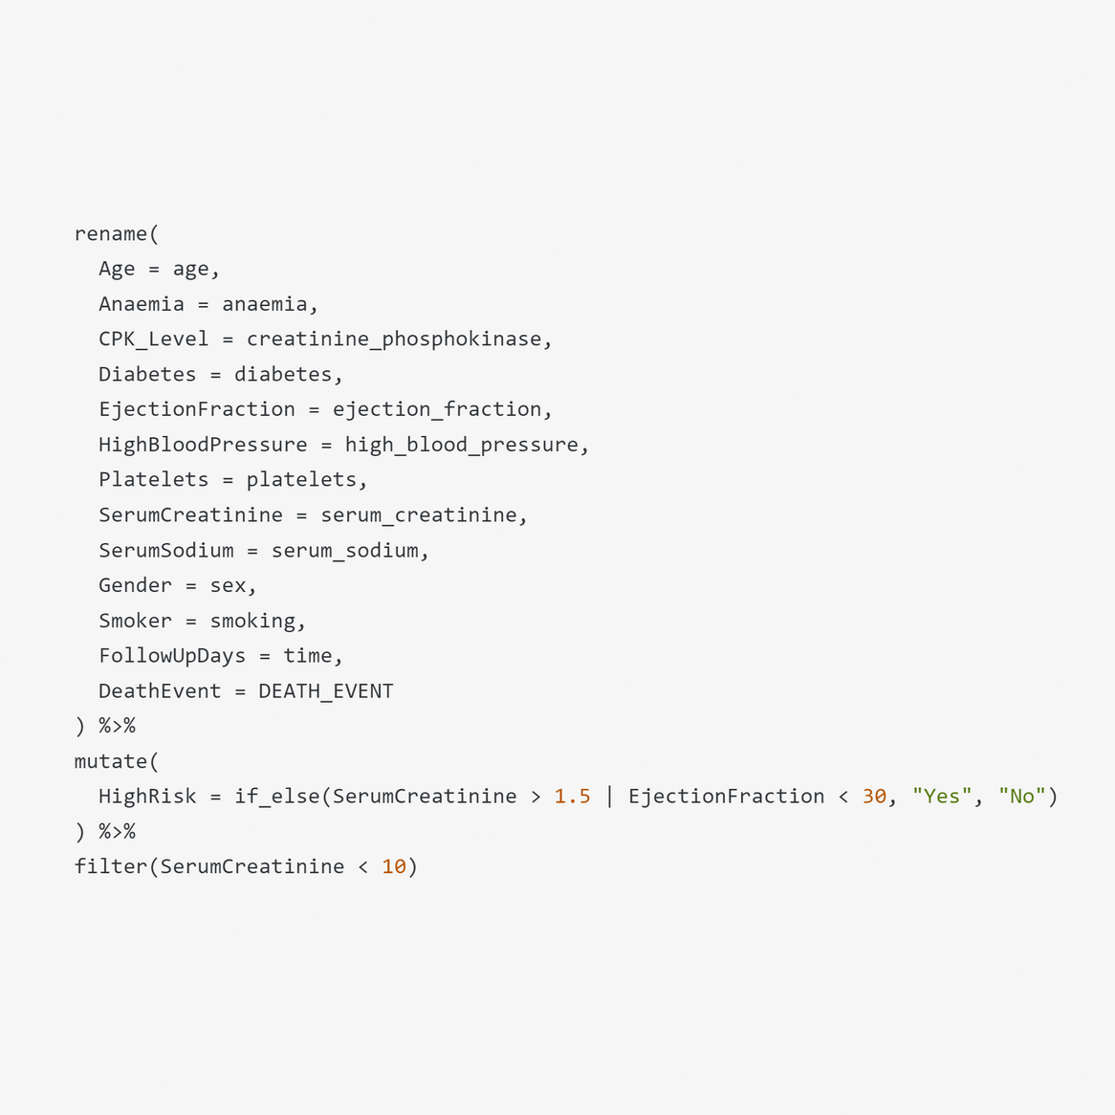
4. DATA CLEANING AND FORMATTING​
Objective: Prepare data for accurate analysis.
Renaming Variables for clarity:
age to Age, anaemia to Anaemia, etc.
Creating New Variables using mutate():
AgeGroup: We use it to categorize ages into group.
HighRisk: It flags the patients as 'Yes' or 'No' based on their risk
level derived from SerumCreatinine and EjectionFraction.
Filtering the Data:
Example: Removed entries where SerumCreatinine was
unusually high (>10).

Slide 5
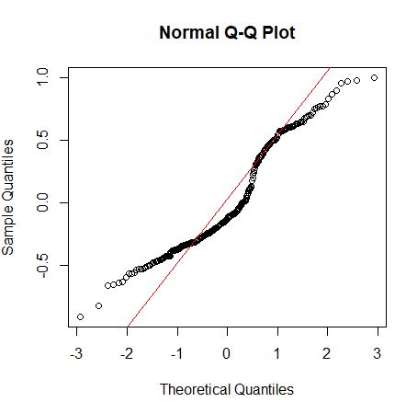
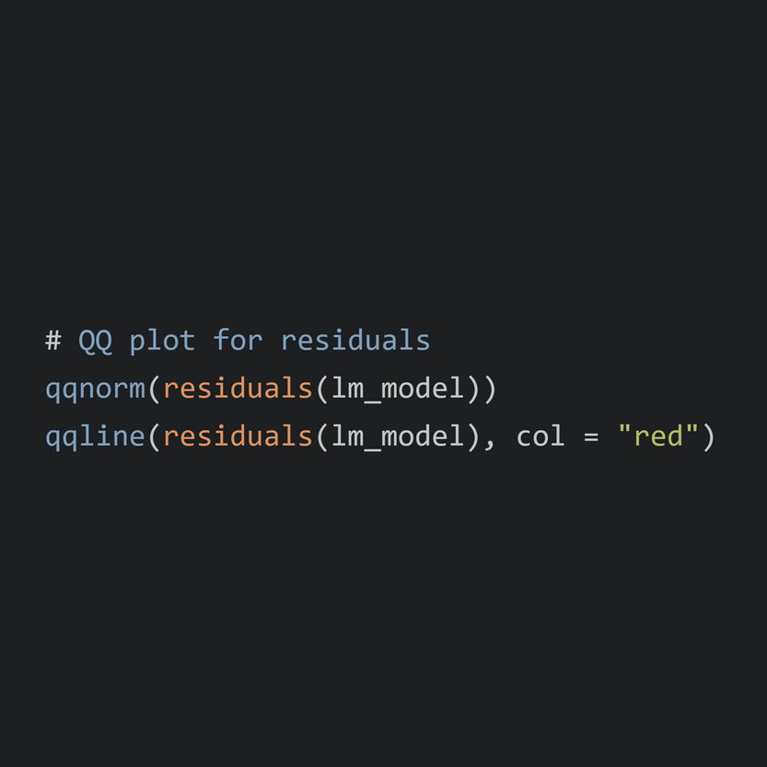

5. CHECKING MODEL ASSUMPTIONS​
Importance: Ensures the validity of model results.
Key Assumptions Checked:
Normality: The idea underpinning residuals is that, if the model is correct
then a variable should reflect a normal distribution..
Linearity:In this analysis, the relationship comparing the predictors and response must be linear.
Homoscedasticity: The constant variety of residuals through predictions.
Methodology:
For normality—and the Gaussian distribution—Q-Q plots were conducted whereas scatter plots were conducted for linearity.
Applied statistical tests to confirm assumptions where needed.
"The Q-Q plot shows that the data is mostly normal, but deviations in the tails suggest outliers."

Slide 6
DETAILED OVERVIEW OF KEY VARIABLES
Age (Numeric): Defined as the time elapsed between discharge and follow-up, and represents the patient’s age at the follow-up. Total observations: 299. No missing values.
Anaemia (Factor): These include 1 or 0 to show the presence of anaemia that impacts on red blood cell amounts. Total observations: 299. No missing values.
Creatinine Phosphokinase (CPK_Level) (Numeric): Nova Stat609: A blood test that measures cardiac stress by checking the level of CPK enzyme in the blood in mcg/L. Total observations: 299. No missing values.
Diabetes (Factor): An indicator used to measure the presence of diabetes as per the patient (1 =Yes, 0 =No). Total observations: 299. No missing values.
Ejection Fraction (Numeric): The degree of blood ejected from the heart in relation to the total amount of blood contained in it during contraction. Echocardiographic – obtuse points to deficits in regard to heart function. Total observations: 299. No missing values.
High Blood Pressure (Factor): Works to identify hypertensive status (1 = yes for hypertensive, 0 = no for non-hypertensive). Total observations: 299. No missing values.
Platelets (Numeric): Highlighted blood components such as total count of blood platelets needed in clot formation. Total observations: 299. No missing values.
Serum Creatinine (Numeric): A blood test that is used as a symbol of kidney function showing the concentration of creatinine in serum. Total observations: 299. No missing values.
Serum Sodium (Numeric): Sodium levels, in particular, indicate serious consequences; Increased levels in the blood. Total observations: 299. No missing values.
Sex (Factor): Patient’s sex (If in Male, then get the value as 1 otherwise if Female then the value as 0). Total observations: 299. No missing values.
Smoking (Factor): Smoking status; where 1 signifies that the client is a smoker and 0 indicates that the client is a non-smoker. Total observations: 299. No missing values.
Time (Numeric): Number of days that participants were followed; standard and critical for survival analysis. Total observations: 299. No missing values.
Death Event (Factor): Demographic and clinical characterizes by follows: Age; Gender; Is the patient dead at the follow-up period (1 = Yes, 0 = No).
Total observations: 299. No missing values.

Slide 7
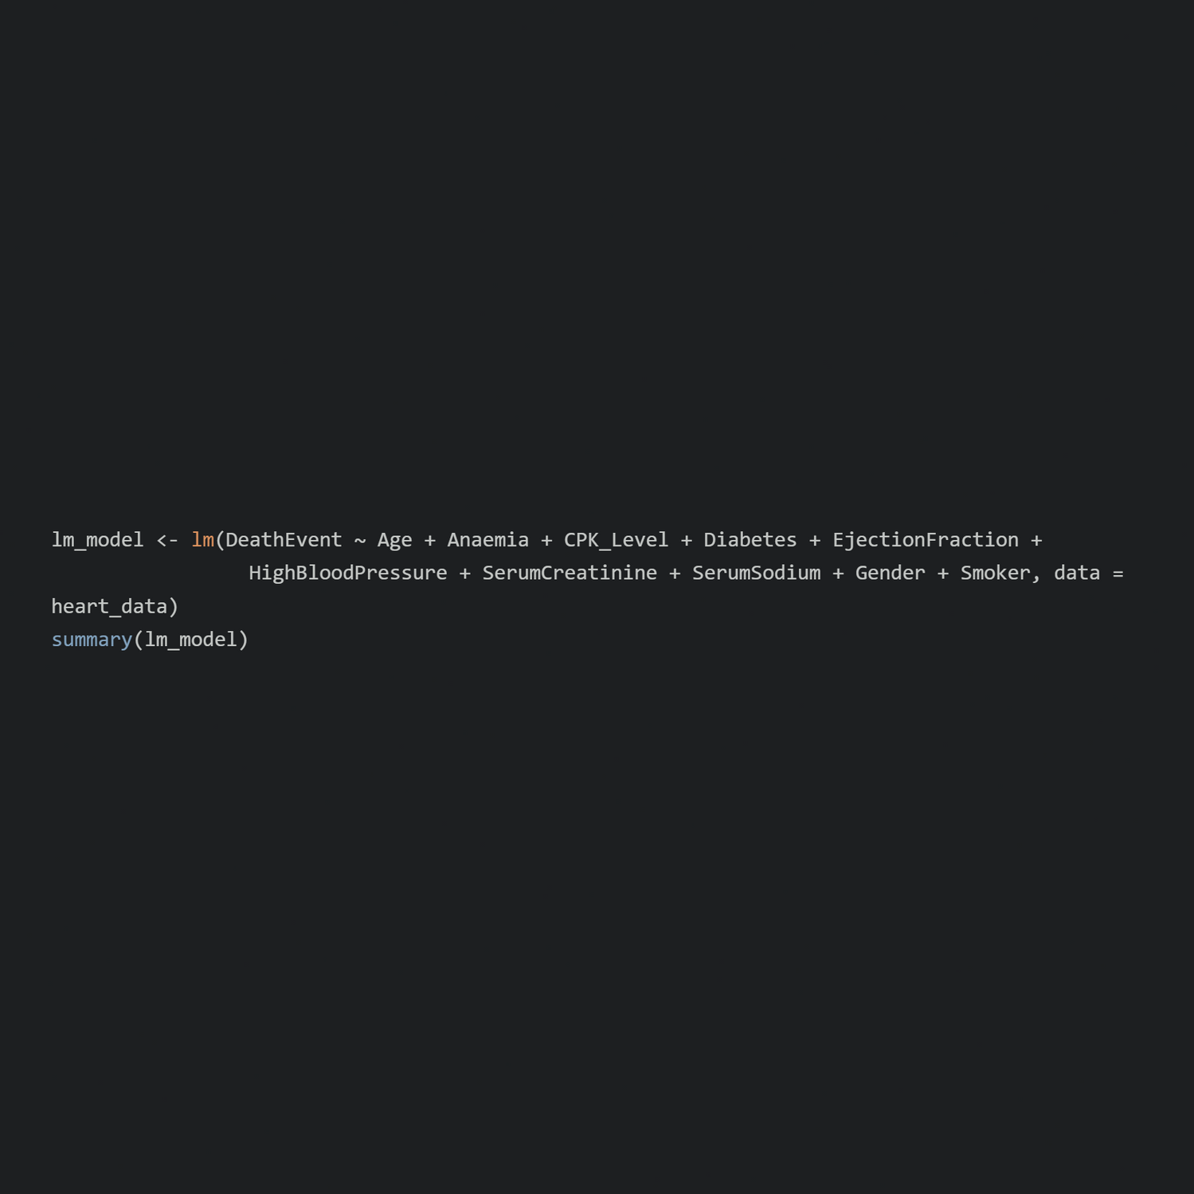
MODEL CHOICE
Objectives of Using Multiple Linear Regression:
Quantifying Relationships: In regards to the inpatient dataset to determine how different parameters affect the probability of a death event in patient diagnosed with heart failure.
Identifying Significant Predictors: In order to know which variables affect mortality to a very large extent or to any extent at all.
Guiding Clinical Decisions: To provide clinicians with a decision support tool that would have the ability of forecasting patients’ clinical outcomes.
Expected Outcomes:
Develop a Predictive Model: Exposure of the risk of death events in patients with heart failure.
Enhance Understanding: Leading evidence-based practice can help obtain the information about which factors contribute most significantly towards the prognosis of the patients.
Support Further Research: Exemplar guide advance research relative to the surviving management of heart failure.

Slide 8
Packages and Tools
dplyr:
Purpose: Data manipulation and cleaning.
Key Functions: mutate(), rename(), filter()
readr:
Purpose: Reading data from CSV files.
Key Functions: read_csv()
ggplot2:
Purpose: Data visualization.
Key Functions: ggplot(), geom_histogram(), geom_bar(), geom_boxplot(), geom_point()
stats (Base R):
Purpose: Statistical modeling.
Key Functions: lm(), summary(), qqnorm(), qqline()

Slide 9
Descriptive Statistics
Variable | Mean | Median | Std. Dev. | Min | Max
Age | 60.83 | 60 | 11.89 | 40 | 95
Anaemia | 0.43 | 0 | 0.50 | 0 | 1
CPK_Level | 581.84 | 250 | 970.29 | 23 | 7861
Diabetes | 0.42 | 0 | 0.49 | 0 | 1
EjectionFraction | 38.08 | 38 | 11.83 | 14 | 80
HighBloodPressure | 0.35 | 0 | 0.48 | 0 | 1
Platelets | 263358.03 | 262000 | 97804.24 | 25100 | 850000
SerumCreatinine | 1.39 | 1.1 | 1.03 | 0.5 | 9.4
SerumSodium | 136.63 | 137 | 4.41 | 113 | 148
Gender | 0.65 | 1 | 0.48 | 0 | 1
Smoker | 0.32 | 0 | 0.47 | 0 | 1
FollowUpDays | 130.26 | 115 | 77.57 | 4 | 285
DeathEvent | 0.32 | 0 | 0.47 | 0 | 1

Slide 10
Regression Model Summary
Dependent Variable: DeathEvent
Independent Variables: Age, Anaemia, CPK_Level, Diabetes, EjectionFraction, HighBloodPressure, SerumCreatinine, SerumSodium, Gender, Smoker
Variable | Coefficient | Std. Error | t-Statistic | p-Value | Variable
(Intercept) | -0.8522 | 0.3191 | -2.670 | 0.0080 | (Intercept)
Age | 0.0009 | 0.0030 | 0.303 | 0.7623 | Age
Anaemia | 0.0522 | 0.0515 | 1.013 | 0.3118 | Anaemia
CPK_Level | 0.0001 | 0.0000 | 2.634 | 0.0090 | CPK_Level
Diabetes | -0.0138 | 0.0503 | -0.273 | 0.7848 | Diabetes
EjectionFraction | -0.0187 | 0.0029 | -6.500 | 0.0000 | EjectionFraction
HighBloodPressure | 0.0633 | 0.0520 | 1.216 | 0.2253 | HighBloodPressure
SerumCreatinine | 0.2090 | 0.0324 | 6.441 | 0.0000 | SerumCreatinine
SerumSodium | -0.0055 | 0.0042 | -1.297 | 0.1965 | SerumSodium
Gender | -0.0908 | 0.0499 | -1.820 | 0.0700 | Gender
Smoker | -0.0162 | 0.0534 | -0.303 | 0.7618 | Smoker

Slide 11
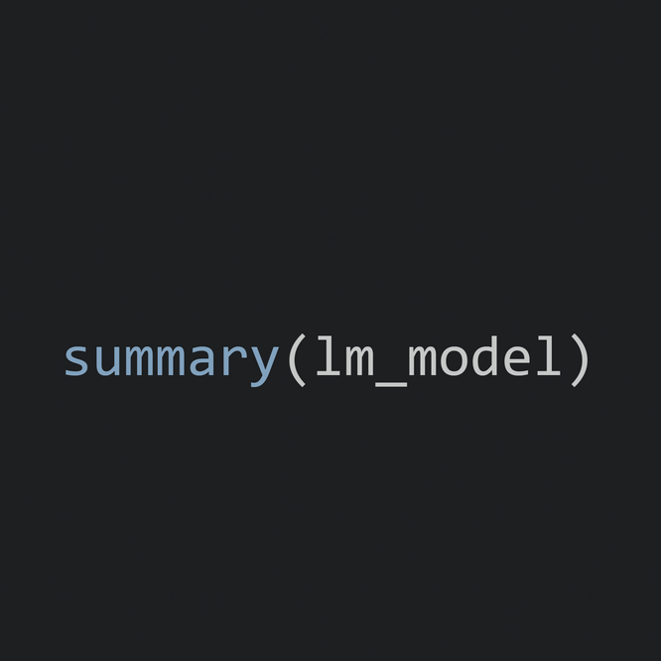
Results
Key Findings:
Intercept: The baseline probability of a death event is approximately -0.8522.
Significant Predictors:
CPK_Level: Each unit increase in CPK levels increases the risk of a death event by 0.0001.
EjectionFraction: Each unit increase in ejection fraction decreases the risk by 0.0187.
SerumCreatinine: Each unit increase in serum creatinine increases the risk by 0.2090.
Model Performance:
R-squared: 0.4158
Adjusted R-squared: 0.2093
Interpretation:
The model explains approximately 45.5% of the variance in death events.

Slide 12
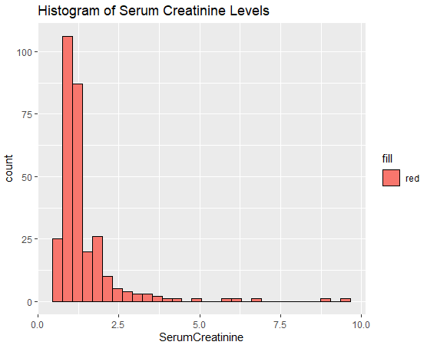
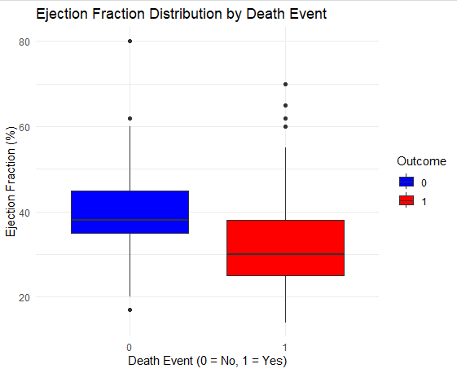
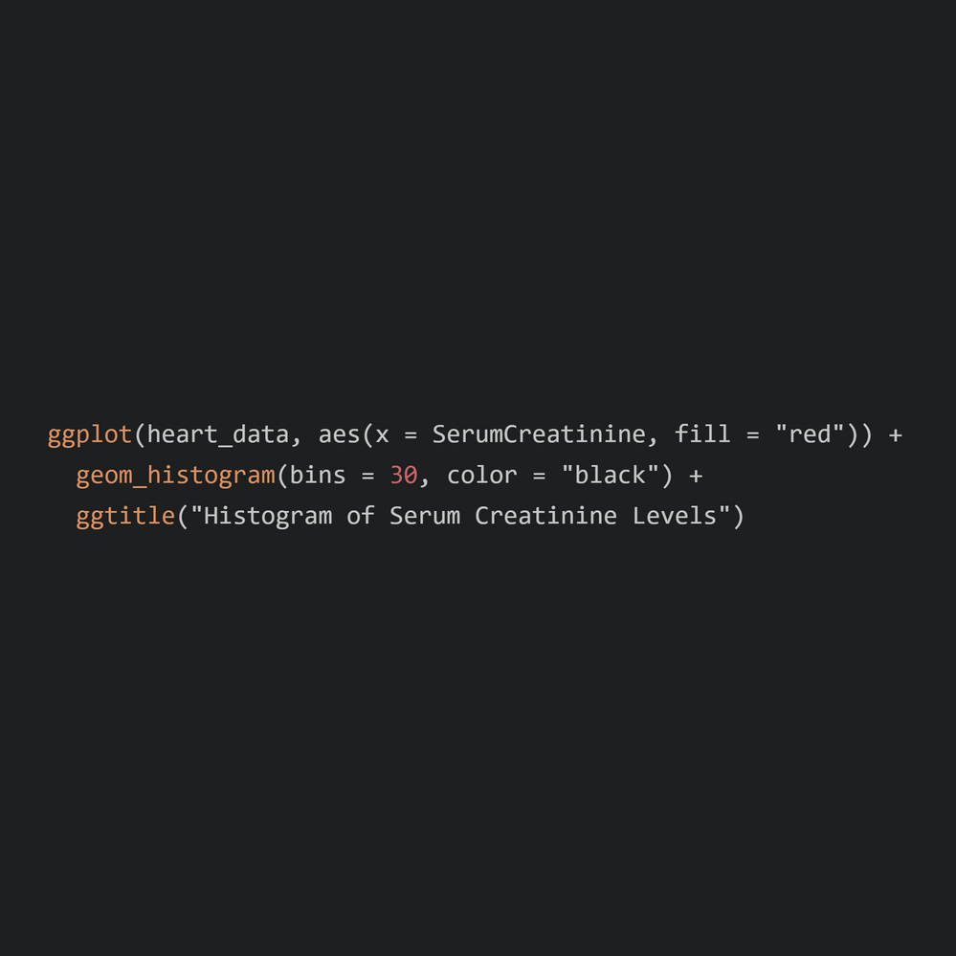
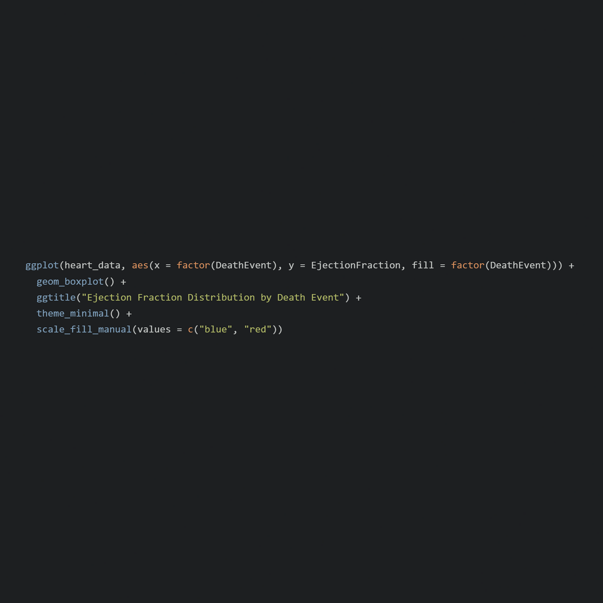
Visual Analysis of Key Health Indicators

Slide 13
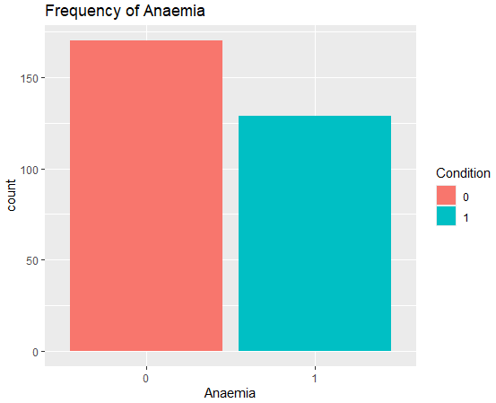
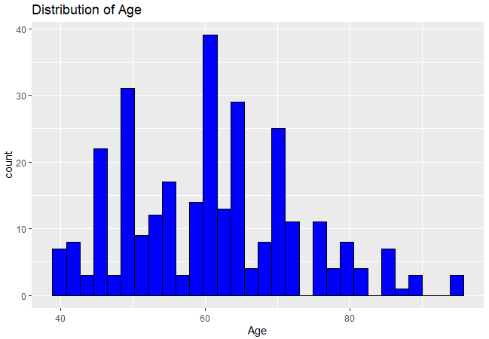
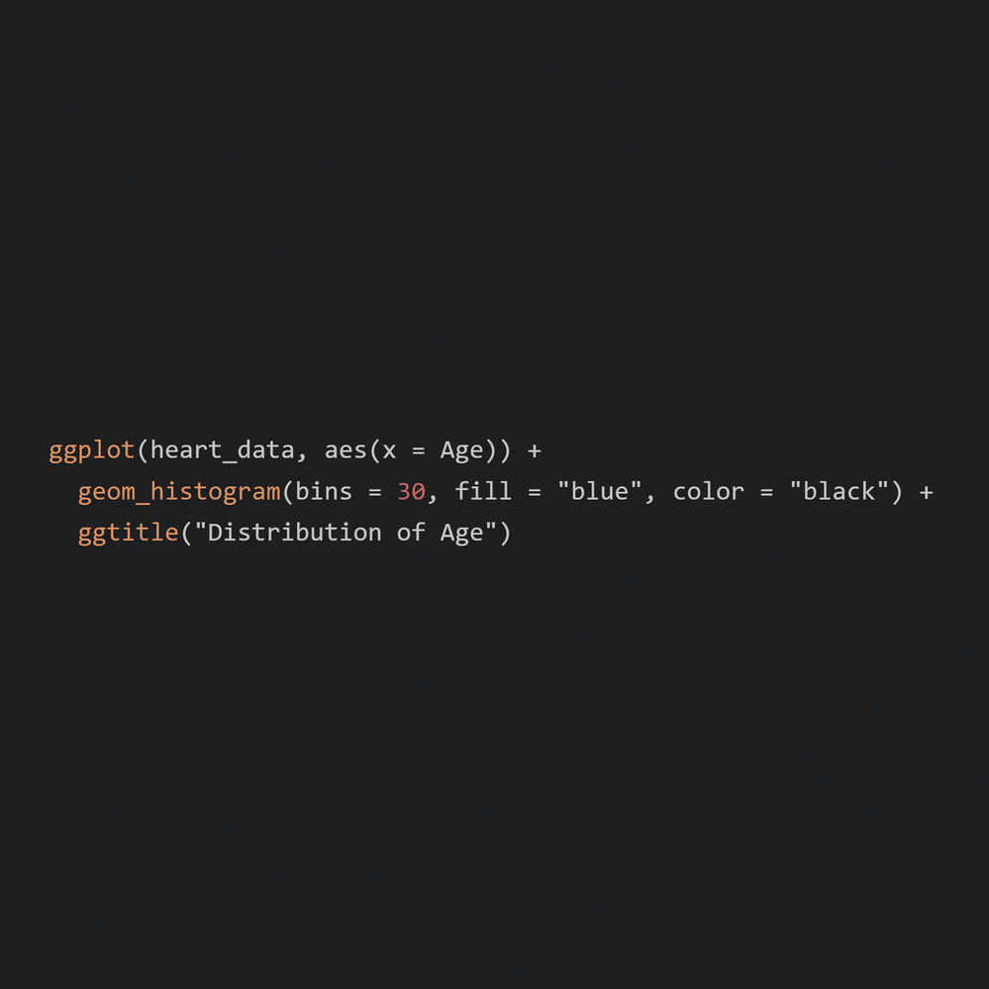
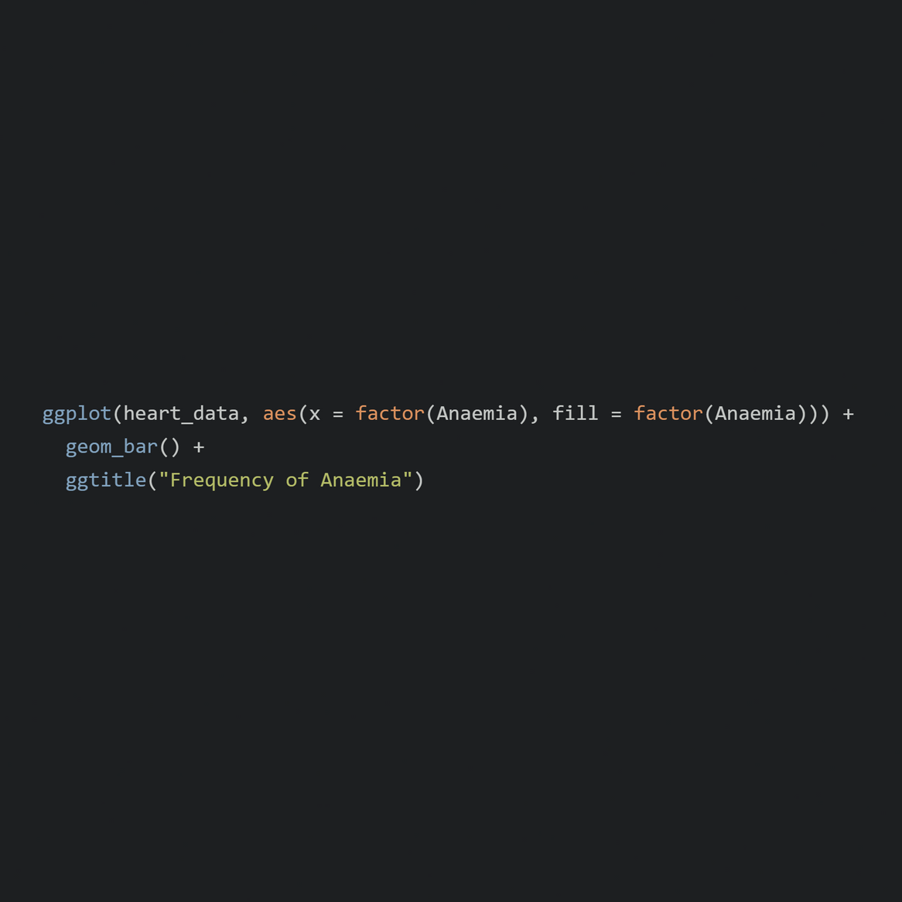
Visual Analysis of Key Health Indicators

Slide 14
Conclusion
The regression analysis indicates that variables such as CPK_Level,
EjectionFraction, and SerumCreatinine are significant predictors of DeathEvent.
Key findings:
CPK_Level: Higher levels of creatinine phosphokinase increase the risk of death.
EjectionFraction: Lower ejection fraction increases the risk of death.
SerumCreatinine: Higher serum creatinine levels increase the risk of death.
Model performance: The model explains approximately 45.5% of the variance in death events.
Significance: The insights gained from this analysis can help in identifying high-risk patients and improving their treatment strategies.

Slide 15


